Slide 1
vSphere Data Protector (VDP)
REDACTED
Tony Foster @wonder_nerd
Systems Engineer
vExpert 2012, VCP 4/5
Eagle Software, Inc. Salina KS

Slide 2
Legal Mumbo Jumbo VDP Statements
REDACTED
The material contained herein is based on Beta interactions with this product.
Functionality, operations, views, screen captures, and all other features & functions described or contained herein may differ in the GA release of the software.
The views and opinions expressed herein are those of the presenter & do not constitute or reflect the views of VMware, Inc., it’s partners, or associated entities, or the presenters employer.

Slide 3
What is VDP
REDACTED
VDP is a fast powerful backup tool for VM’s
Constructed using EMC’s Avamar backup solution.
Provides deduplication across all VDP backups.
Fully integrated with the vSphere Web Interface
End user file level recovery capabilities
Its included with vSphere 5.1 Essentials Plus licensing & above

Slide 4
What VDP is not
REDACTED
VMware Data Recovery (VDR) rebranded.
A way to backup to tape.
Incompatible with your existing backup solution.
Complicated
Agent based.

Slide 5
What do we need for VDP?
REDACTED
VMware vCenter Server 5.1
VMware ESX/ESXi 4.0, 4.0i, 4.1i, 5.0i, 5.1
The VDP Appliance
Review the VDP documentation to determine the correct size and quantity of VDP appliances you need.
Best Practice: Is to use storage not associated with the VM’s you are going to protect.

Slide 6
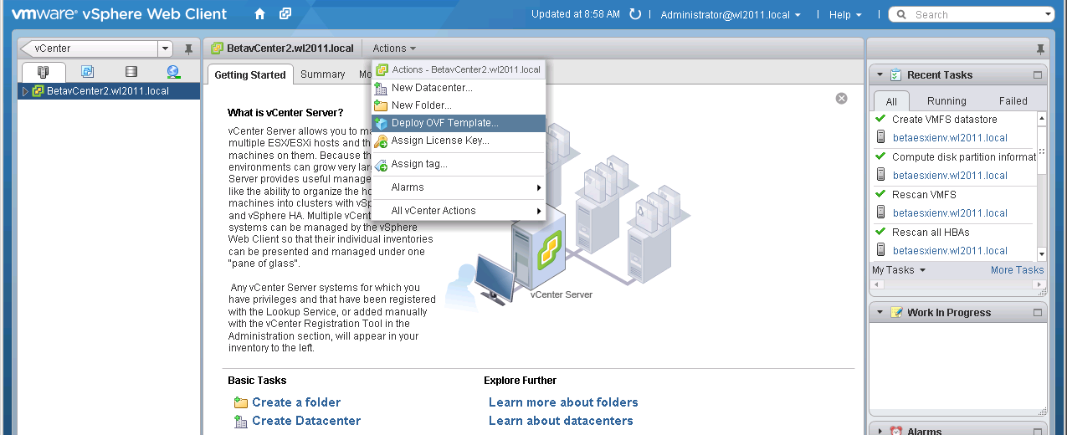
Setting up VDP
REDACTED
We’ll navigate to our vCenter and under the Actions drop down Deploy the VDP OVF

Slide 7
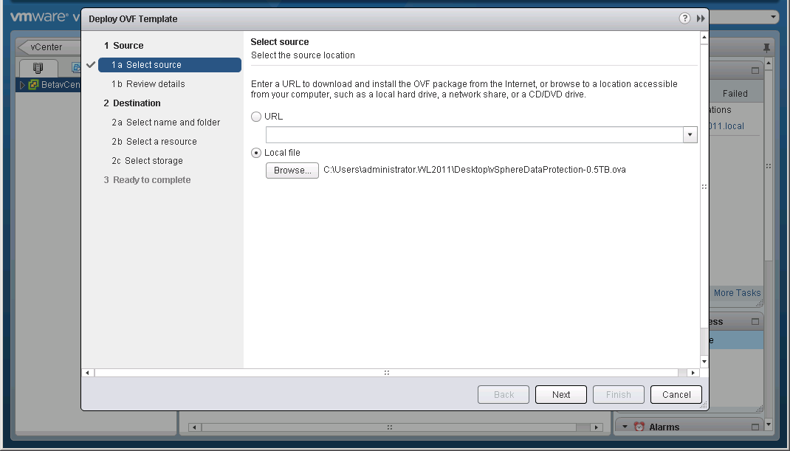
Setting up VDP
REDACTED
We select the OVF for the VDP appliance.

Slide 8
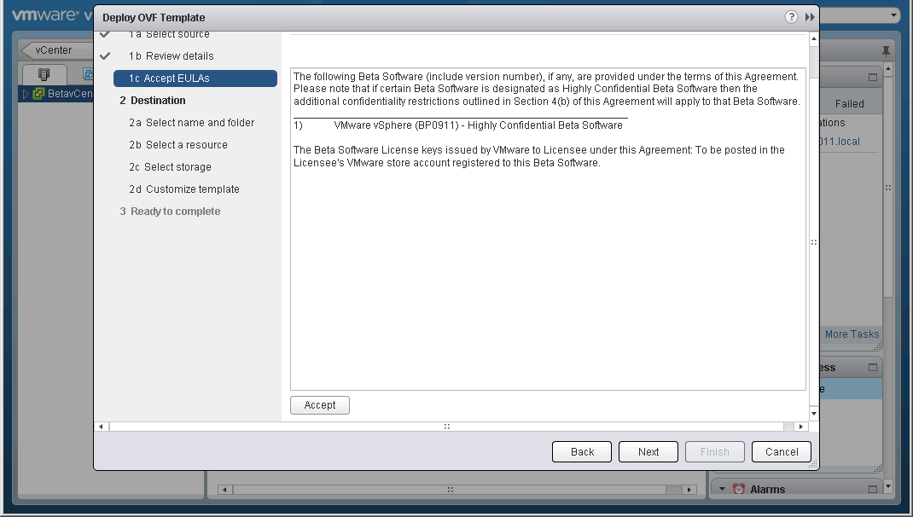
Setting up VDP
REDACTED
Review the EULA (this will look differently in the GA release).

Slide 9
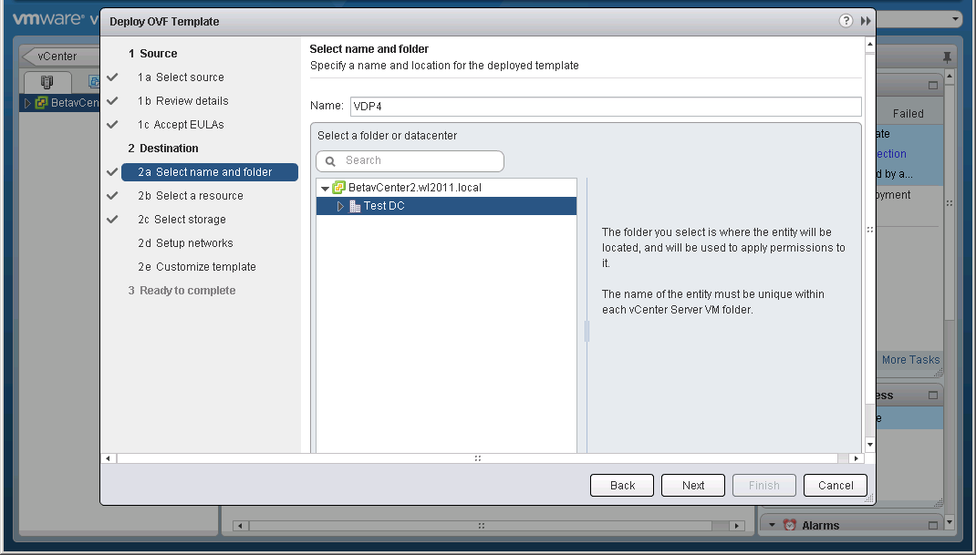
Setting up VDP
REDACTED
Select the location to deploy the appliance.

Slide 10
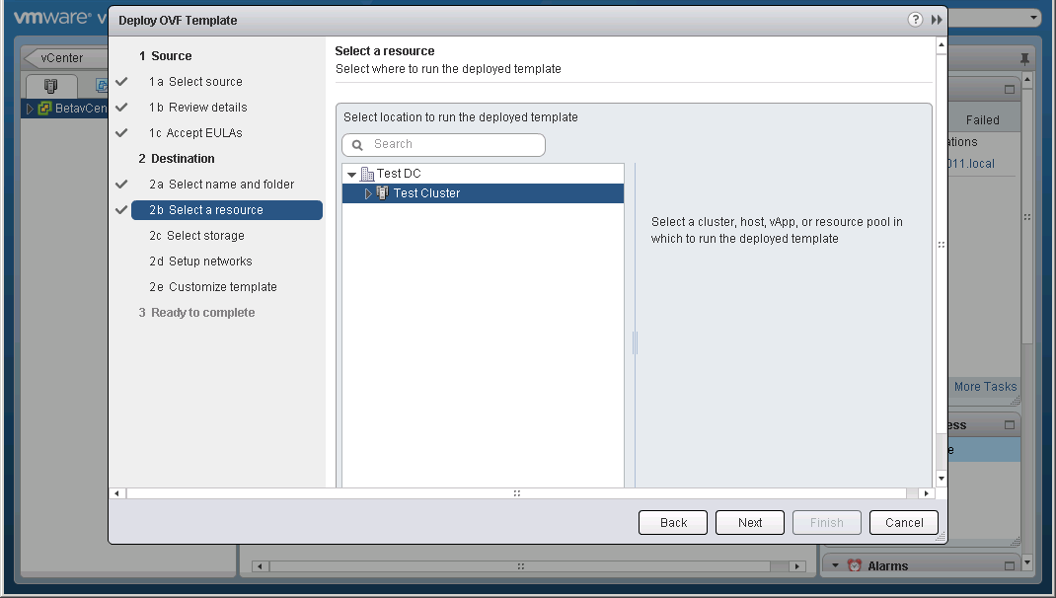
Setting up VDP
REDACTED
Select the appropriate resources

Slide 11
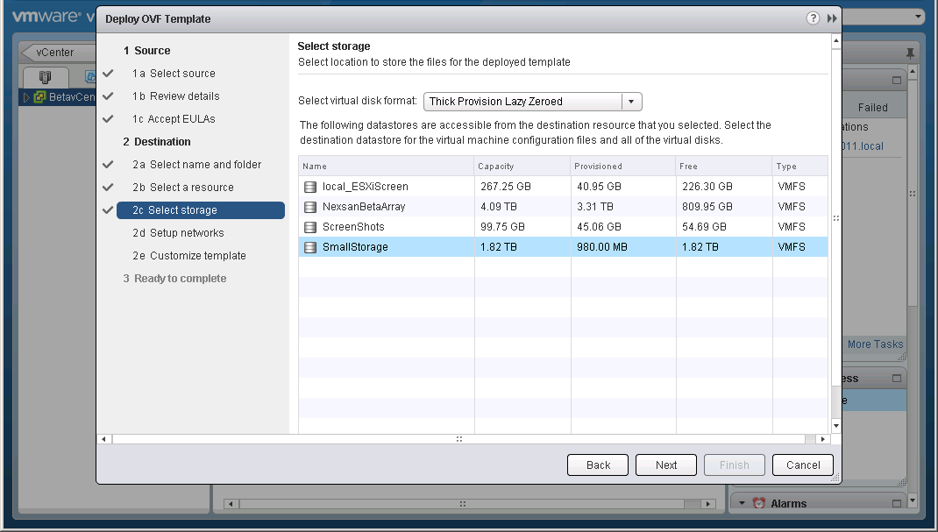
Setting up VDP
REDACTED
Select the storage to house the Appliance.

Slide 12
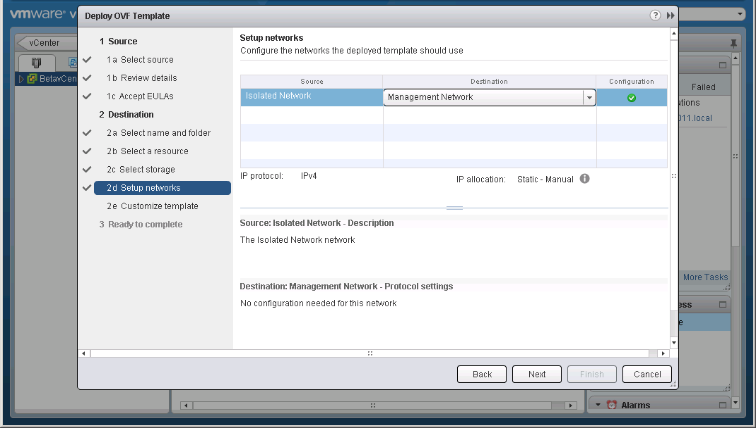
Setting up VDP
REDACTED
Connect the appliance to the appropriate network.

Slide 13
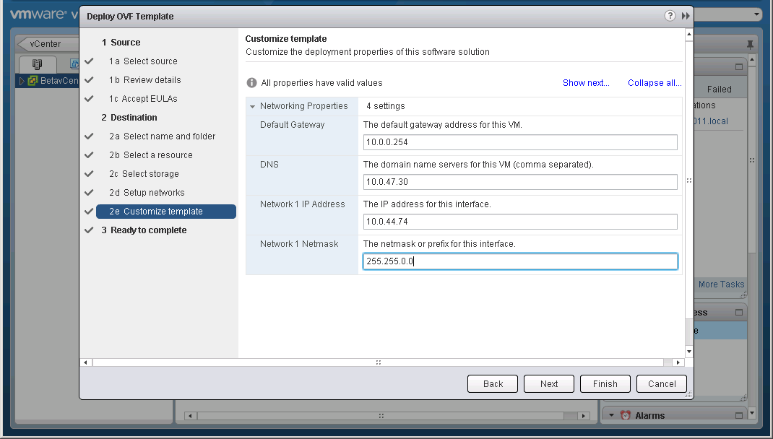
Setting up VDP
REDACTED
Enter basic setup information for the appliance.

Slide 14
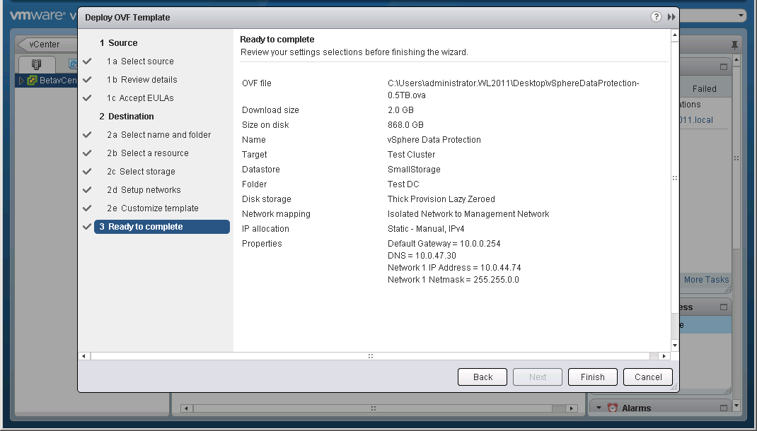
Setting up VDP
REDACTED
Confirm the settings.

Slide 15
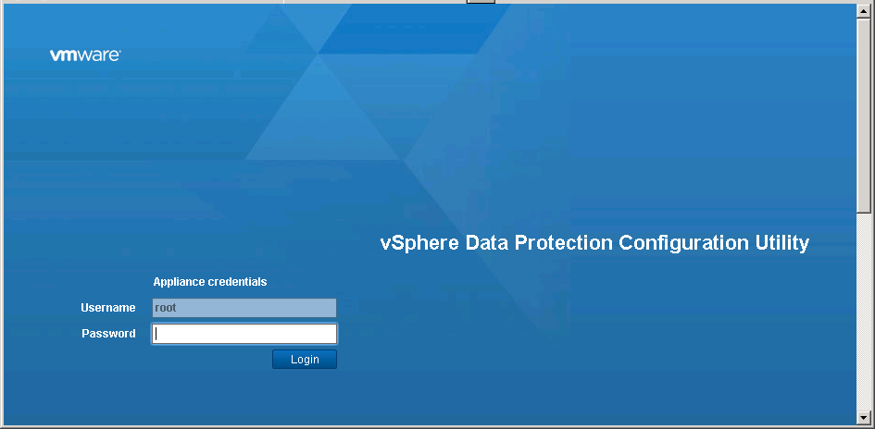
Setting up VDP
REDACTED
Open a browser to the name of the appliance at port 8543. (https://<appliance>:8543/vdp-configure/)

Slide 16
Setting up VDP
REDACTED
Login to the appliance with:
User: root
Password: changeme

Slide 17
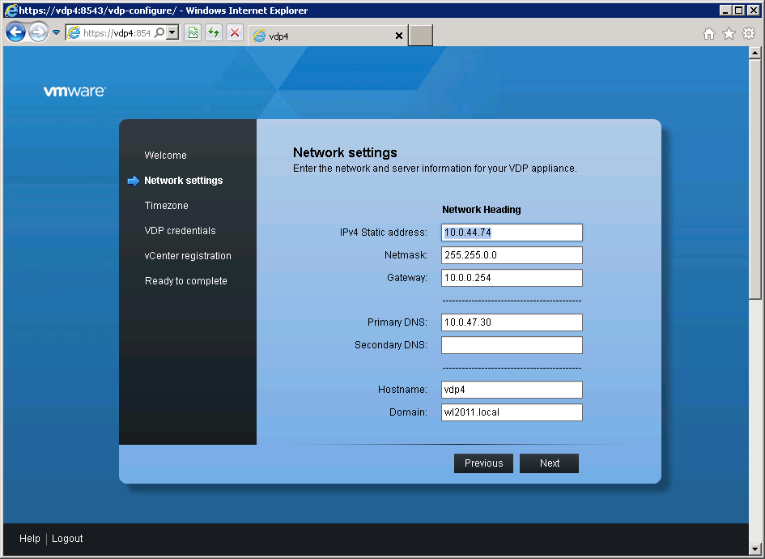
Setting up VDP
REDACTED
Review the network settings.

Slide 18
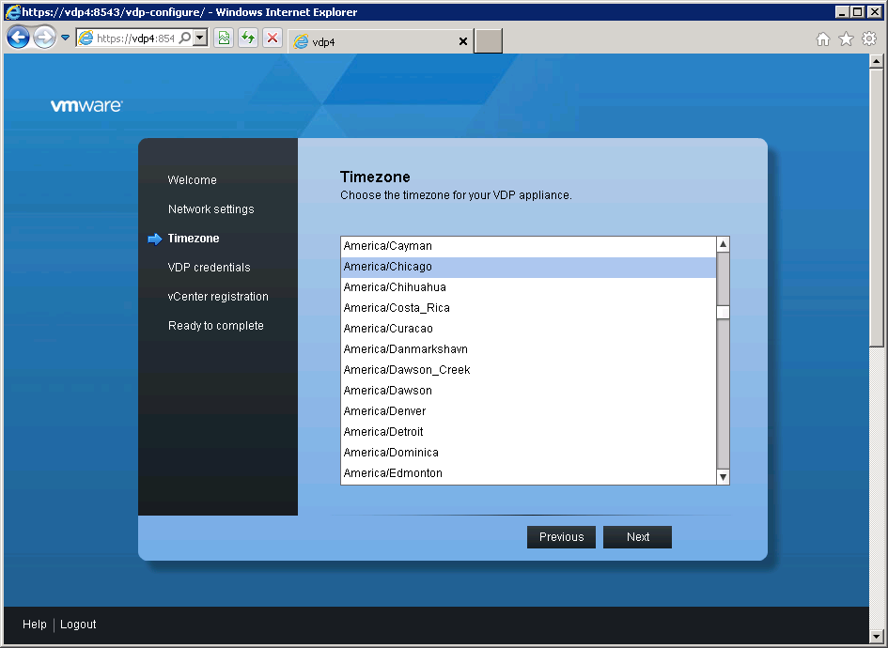
Setting up VDP
REDACTED
Set the time zone for the appliance.

Slide 19
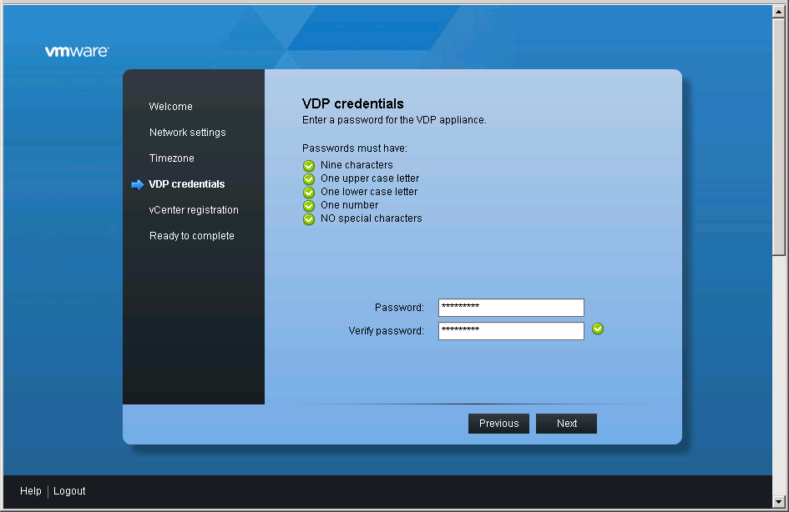
Setting up VDP
REDACTED
Create a VDP password to replace changeme

Slide 20
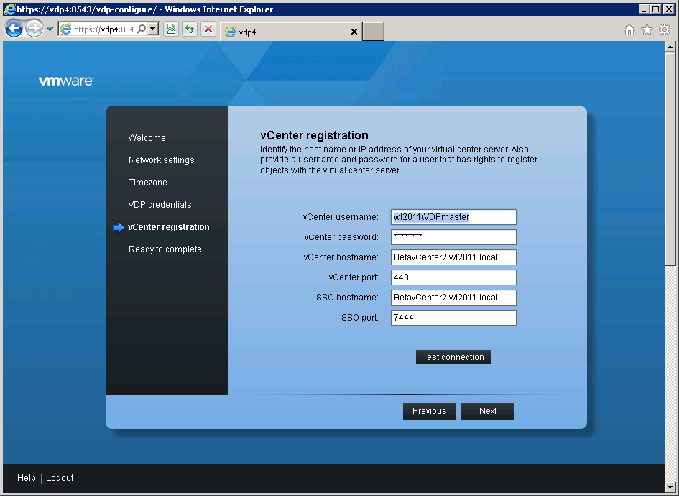
Setting up VDP
REDACTED
Enter credentials for the vCenter.

Slide 21
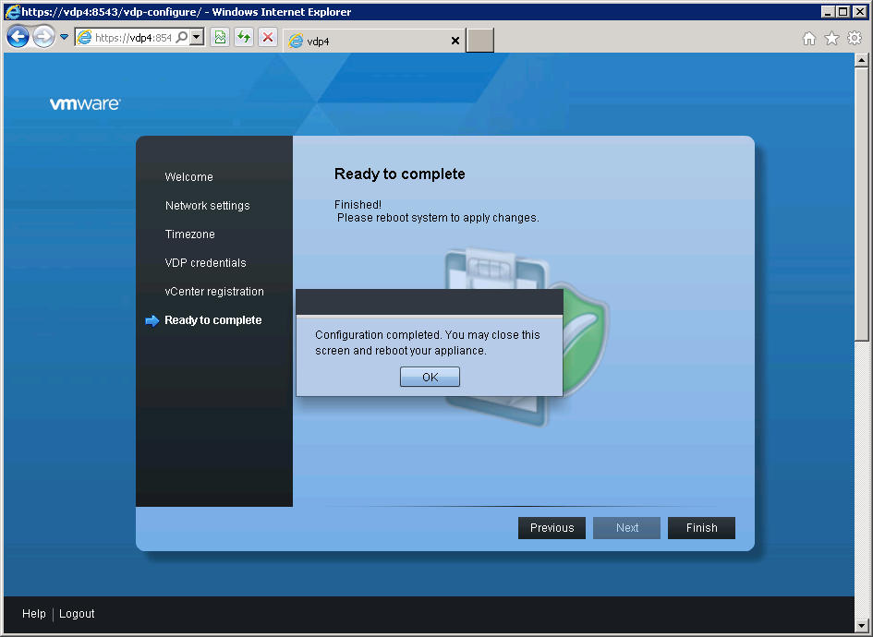
Setting up VDP
REDACTED
Reboot the Appliance.

Slide 22
Setting up VDP
REDACTED
And now we wait ~ 30 minutes while it sets up.
That’s it. We are ready to use VDP

Slide 23
VDP Caveats
REDACTED
DNS resolution must be working correctly.
The appliances password must be 9 characters long.
Best Practice: Storage should be different from where your production VM’s are stored.

Slide 24
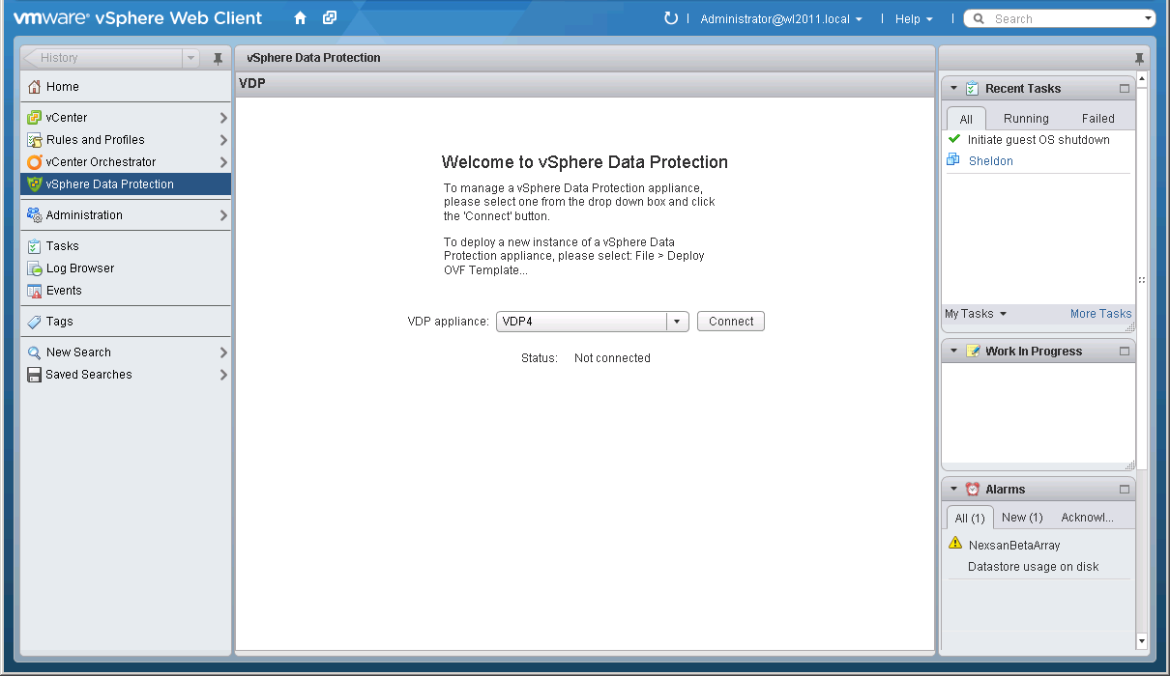
Backups with VDP
REDACTED
We’ll connect to our VDP appliance in the vSphere Web Client.

Slide 25
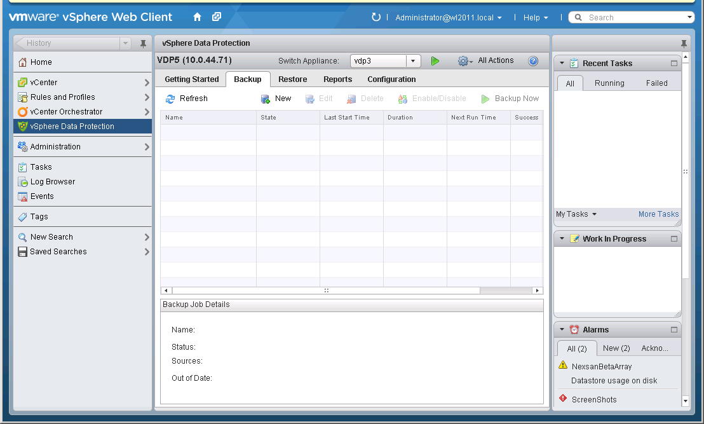
Backups with VDP
REDACTED
Click the New button to create a backup

Slide 26
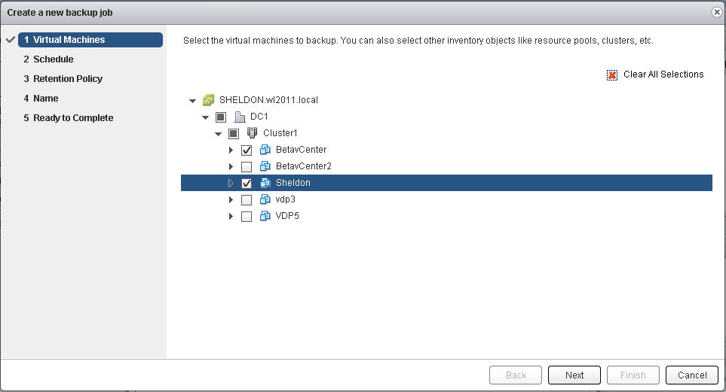
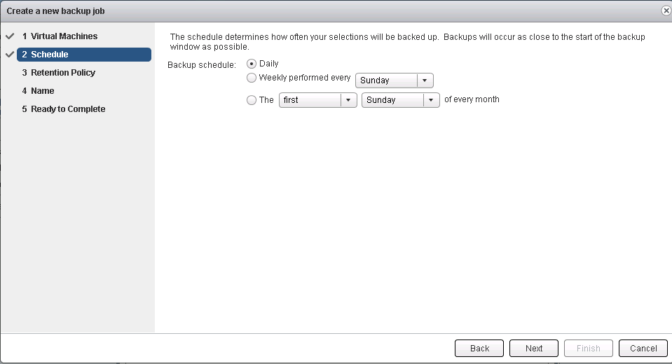
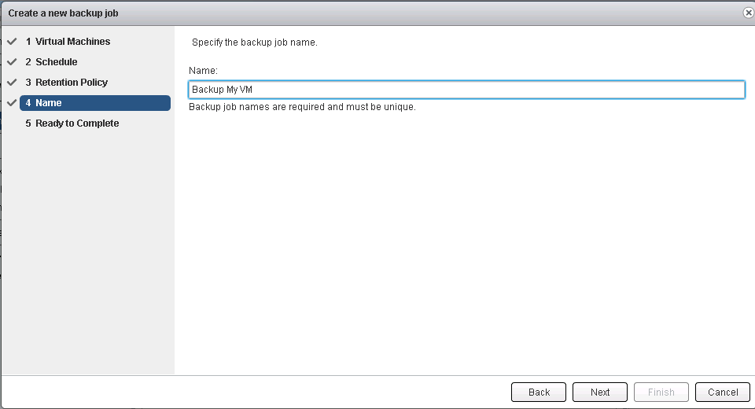
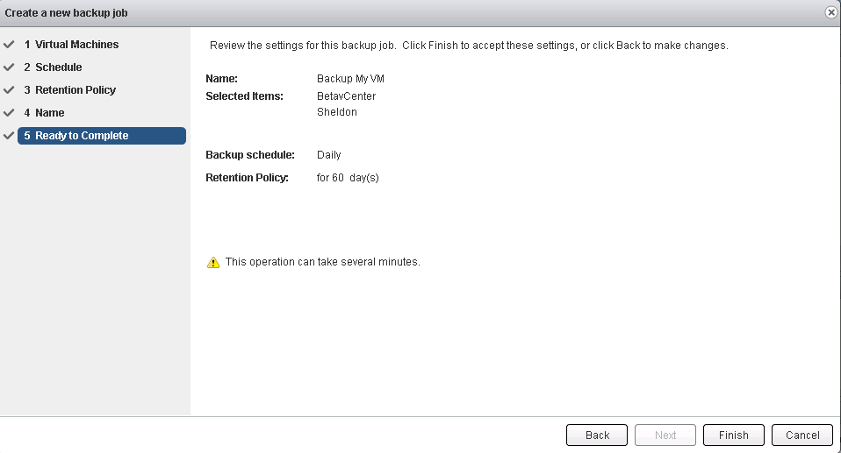
Backups with VDP
REDACTED
We’ll follow the bouncing ball to configure a backup.

Slide 27
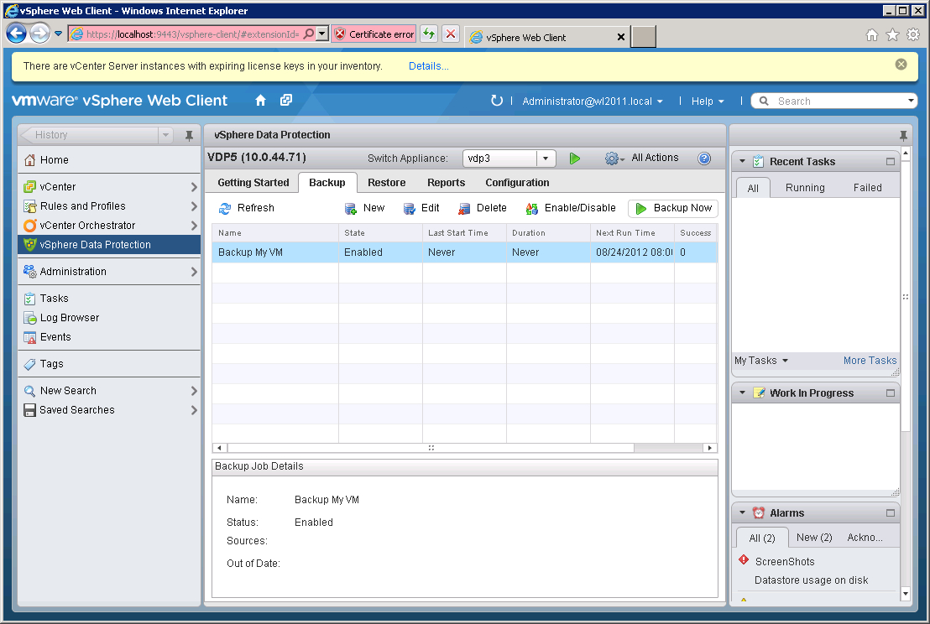
Backups with VDP
REDACTED
To start a backup we’ll click the Backup Now button

Slide 28
Scheduling VDP Backups
REDACTED
Note: Backups occur at the end of the maintenance window or when run administratively with the Backup Now button.

Slide 29
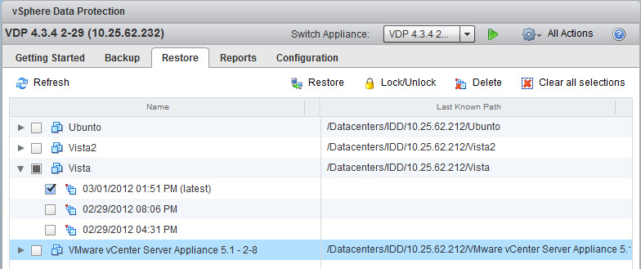
Whole VM Restores VDP
REDACTED
To restore a whole VM we can simply go to the Restore tab. Expand the VM we wish to recover and then click the Restore button.

Slide 30
File Level Restores with VDP
REDACTED
We launch the File Level Recovery (FLR) by opening a web browser and pointing it to our VDP appliance.
We can then select the backup we wish to restore from and the file we wish to restore.
Note that the File Level Restore is performed from the VM where the backup was taken.

Slide 31
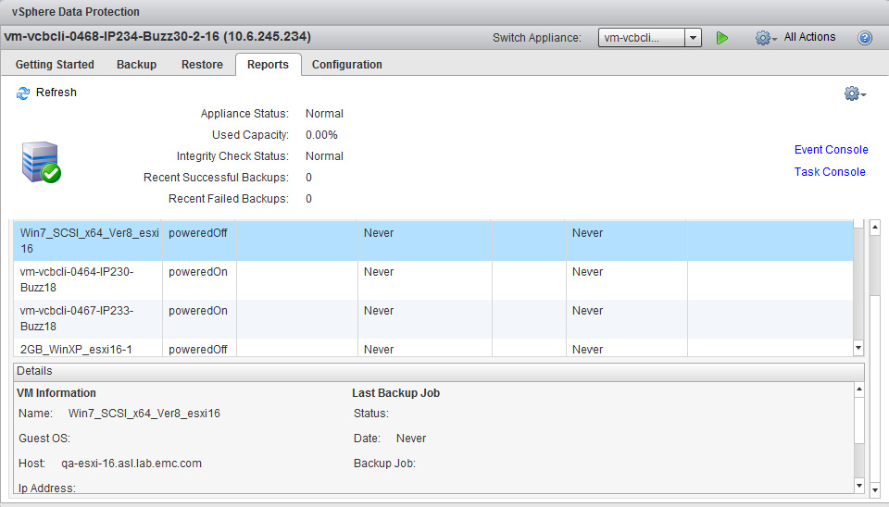
Reports from VDP
REDACTED
VDP reports can be seen through the vSphere Web Client.

Slide 32
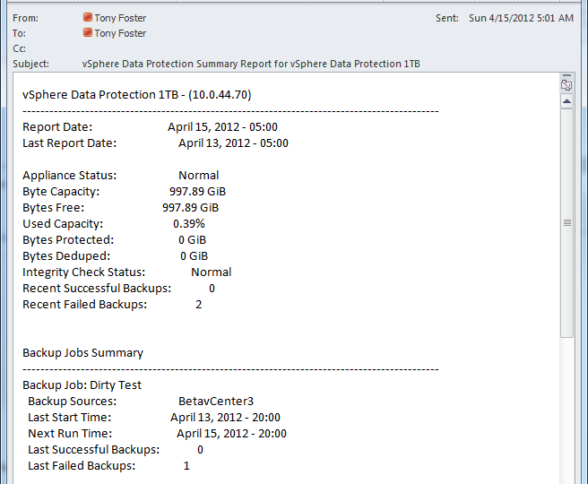
Reports from VDP
REDACTED
VDP also has the ability to email reports daily with the status of backup jobs.

Slide 33
Protecting VDP
REDACTED
Checkpointing allows for protection of the Appliance its self.

Slide 34
My Take on VDP
REDACTED
Great solution that provides enterprise level protection.
Fast & Efficient
Reduces IT staff load by allowing users File Level Restore capabilities.
Simple to use.
And the best part is its free!!!

Slide 35
Reference Material VDP
REDACTED
Chad’s World Episode 7 - http://www.emc.com/community/chads-world/
vSphere Data Protection Administration Guide – http://www.vmware.com/ *
*Documentation links will be added at GA

Slide 36
Quick Questions about VDP
REDACTED
Contact Information:
Company Website: www.totalbackups.com
Personal Website: www.wondernerd.net
@wonder_nerd on Twitter
Email: Tony.Foster@wondernerd.net

